Slide 1
Pemrograman Web 5. Pengenalan CSS
Joko Suntoro
jokosuntoro@usm.ac.id
SMS/Telp: 0822-4236-9670
WA/Telegram: 085-641-970-170
http://jokosuntoro.com

Slide 2

Joko Suntoro
SDN Pandean Lamper 03 Semarang (1995-2001)
SMPN 32 Semarang (2001-2004)
SMA Institut Indonesia Semarang (2004-2007)
S1 Teknik Informatika Universitas Semarang (2010-2015)
S2 Teknik Informatika Universitas Dian Nuswantoro (2015-2016)
Tim Operasi dan Teknik, Domestic Gas PT Pertamina (Persero) (2008-sekarang)
Peneliti dan Reviewer di Romi Satria Wahono (RSW) Intelligent System Research Group
Bidang Penelitian: Data Mining, Intelligent System dan Machine Learning

Slide 3
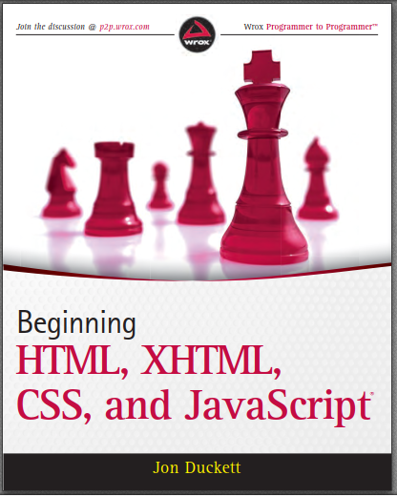
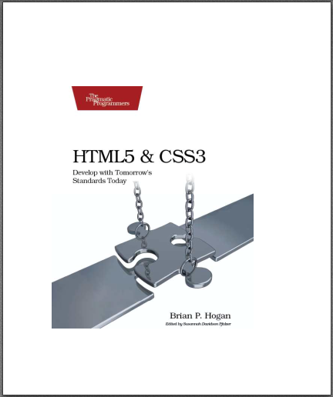
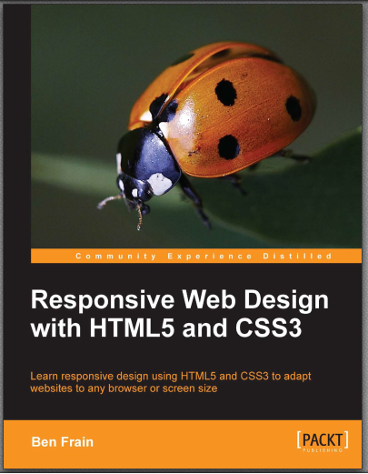

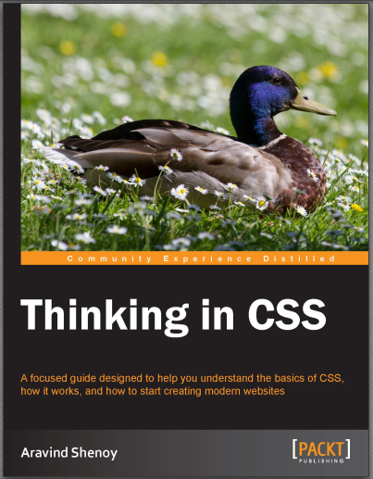
Textbooks
Notes:
Ducket, Frain, Hogan, Shenoy

Slide 4
4.1 Pengenalan CSS

Slide 5
Apa itu CSS?
CSS merupakan singkatan dari Cascading Style Sheets
CSS menjelaskan bagaimana elemen HTML yang akan ditampilkan browser
CSS menghemat banyak pekerjaan. Hal ini dapat mengontrol tata letak halaman web.

Slide 6
4.2 CSS Syntax and Selector

Slide 7
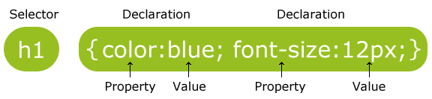
CSS Syntax
Selector: HTML element yang akan diubah style-nya
Declaration: blok deklarasi, berisi satu atau lebih deklarasi

Slide 8
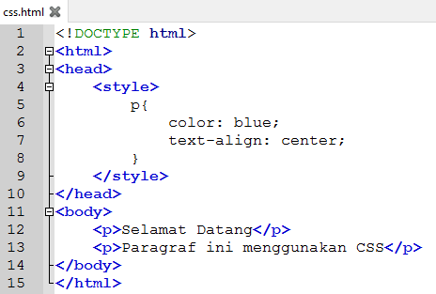
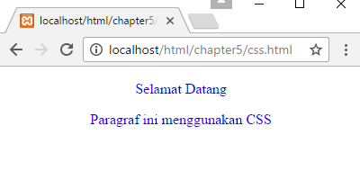
Example CSS Syntax

Slide 9
CSS Selector
CSS Selector
Element Selector
Id Selector
Class Selector
Grouping Selector

Slide 10
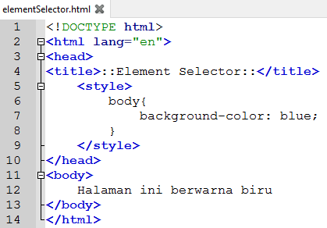
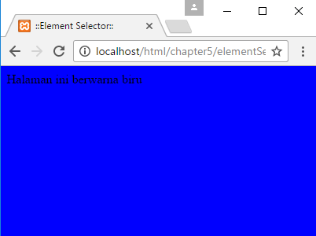
4.2.1 Element Selector
The element selector selects elements based on the element name

Slide 11
4.2.2 Id Selector
The id selector uses the id attribute of an HTML element to select a specific element
The id of an element should be unique within a page
To select an element with a specific id, write a hash (#) character, followed by the id of the element
The style rule below will be applied to the HTML element with id=“text":

Slide 12
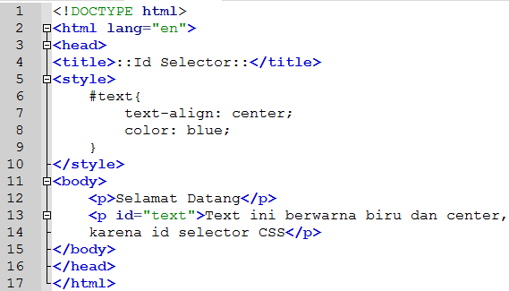
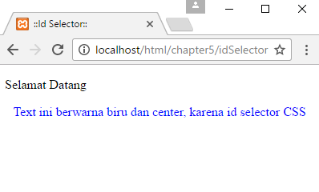
4.2.2 Id Selector

Slide 13
4.2.3 Class Selector
The class selector selects elements with a specific class attribute
To select elements with a specific class, write a period (.) character, followed by the name of the class
In the example below, all HTML elements with class="center-red" will be center-aligned and red

Slide 14
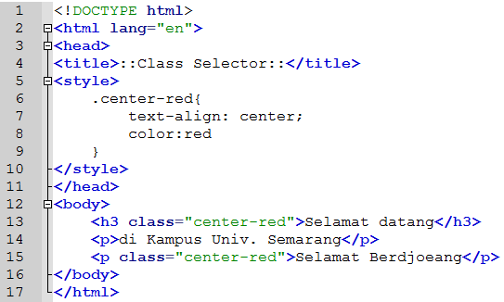
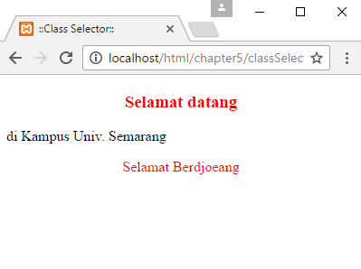
4.2.3 Class Selector

Slide 15
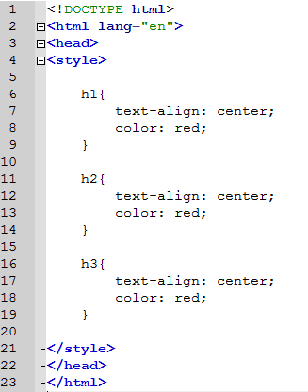
4.2.4 Grouping Selector
If we have elements with the same style definition, like this:

Slide 16
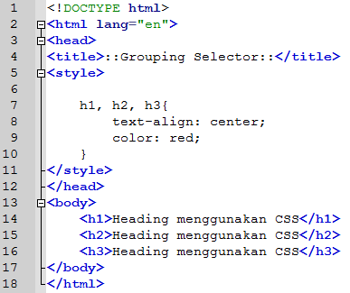
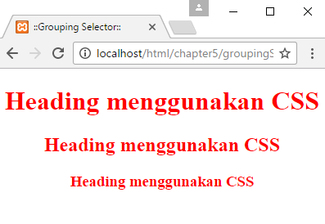
4.2.4 Grouping Selector
We can minimize code using grouping selector

Slide 17
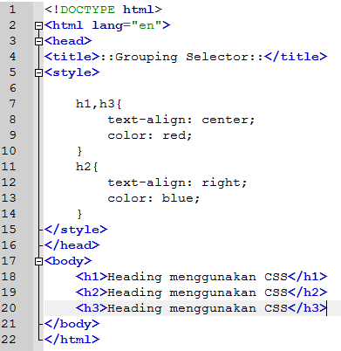
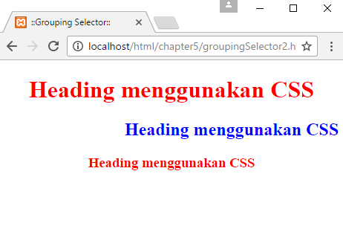
4.2.4 Grouping Selector 2

Slide 18
4.3 Incorporating CSS in HTML

Slide 19
Three Ways to Insert CSS
Inline Style Sheet
Internal Style Sheet
External Style Sheet

Slide 20
4.3.1 Inline Style Sheet
An inline style may be used to apply a unique style for a single element
To use inline styles, add the style attribute to the relevant element. The style attribute can contain any CSS property

Slide 21
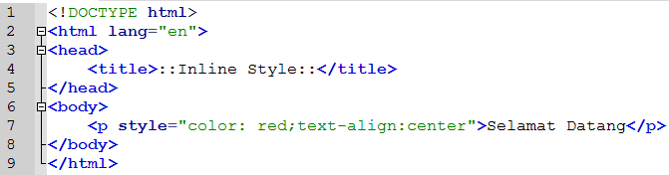
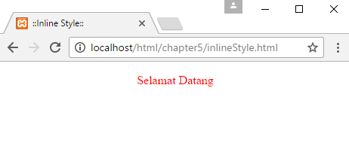
4.3.1 Inline Style Sheet

Slide 22
4.3.2 Internal Style Sheet
An internal style sheet may be used if one single page has a unique style
Internal styles are defined within the <style> element, inside the <head> section of an HTML page

Slide 23
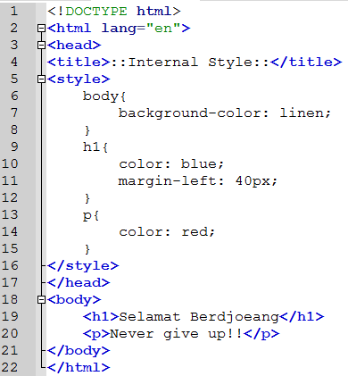
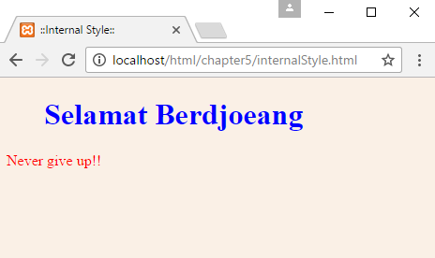
4.3.2 Internal Style Sheet

Slide 24
4.3.3 External Style Sheet
With an external style sheet, you can change the look of an entire website by changing just one file!
Each page must include a reference to the external style sheet file inside the <link> element. The <link> element goes inside the <head> section
An external style sheet can be written in any text editor. The file should not contain any html tags. The style sheet file must be saved with a .css extension

Slide 25
Referensi
Duckett, J. (2010). Begining HTML, XHTML, CSS and JavaScript. (C. Ullman, Ed.). Canada: Willey Publishing, Inc.
Frain, B. (2013). Responsive Web Design with HTML5 and CSS3. (R. de Jongh, Ed.). Birmingham: Packt Publishing Ltd.
Hogan, B. P. (2010). HTML5 and CSS3 Develop with Tomorrow’s Standards Today. United States of America: Pragmatic Programmer, LLC.
Shenoy, A. (2014a). Thinking in CSS. (S. Sukumaran, Ed.). Birmingham: Packt Publishing Ltd.
Shenoy, A. (2014b). Thinking in HTML. (K. Narayanan, Ed.). Brimingham: Packt Publishing Ltd.
Wang, P., & Katila, S. (2003). An introduction to Web design and programming. Brooks-Cole.

